Slide 1



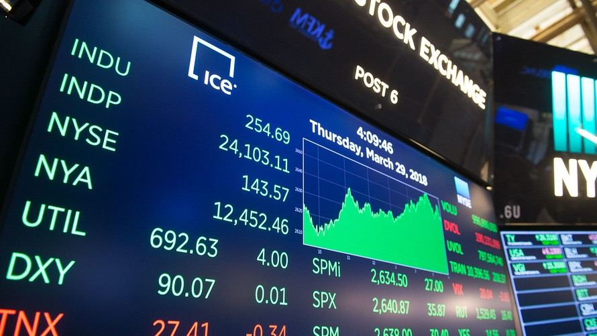
ANALYSIS OF NEWS HEADLINES TO PREDICT STOCK MARKET MOVEMENT
BUDT758X - 0501 – Data Processing and Analysis in Python
Akshita Jaitly
Nirav Taneja
Rahul Raj Singh

Slide 2
AGENDA
Executive Summary
Define the Problem
Challenges
Data Description
Exploratory Analysis
Data Preprocessing/ Feature Engineering
Preprocessing
Sentimental Analysis
Model – LR, NN, XGB
Implications and Discussions

Slide 3
Executive Summary
Efficient Market Hypothesis is the popular theory about stock prediction. With its failure much research has been carried in the area of prediction of stocks.
This project is about taking non quantifiable data such as headlines of news articles and predicting future stock trend with news sentiment classification.
Assuming that news articles have impact on stock market, this is an attempt to study relationship between news and stock trend.

Slide 4
Define the Problem
Is there an impact of positive/negative news headlines on opening/closing stock prices on any given day?
Can we predict the movement of the stock prices by analyzing the text given in news headlines?

Slide 5
Challenges
Merging the Data
Labeling the Data
Deriving Correlations
Improving Accuracy

Slide 6
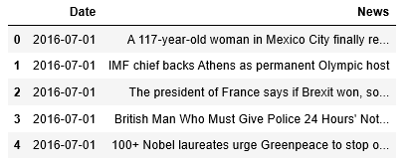
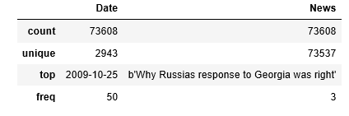
Data description
We are working with the two datasets. The first dataset called Redditnews.csv – which contains news headlines and dates of 73608 news articles dated from 08/08/2008 to 07/01/2016 .

Slide 7
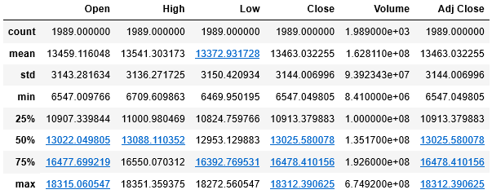
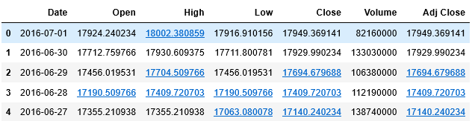
Data description
The second dataset called upload_DJIA_table.csv contains the opening, closing, high, low stock prices dated for the same time period barring weekend(Stock Market Closure)

Slide 8

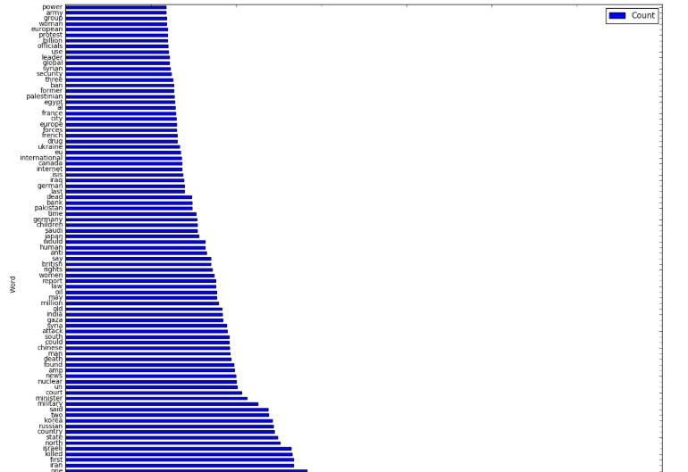
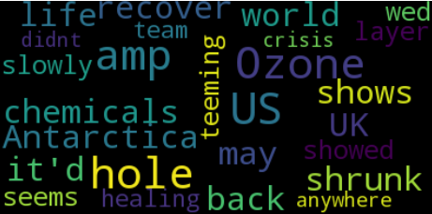
Exploratory Data Analysis

Slide 9
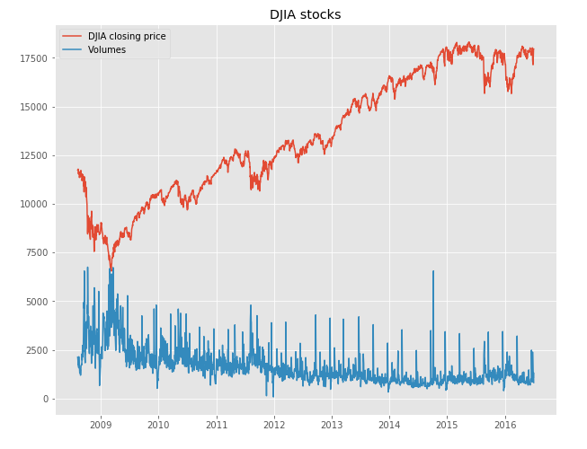
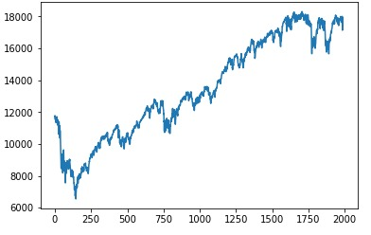
Exploratory Data Analysis

Slide 10
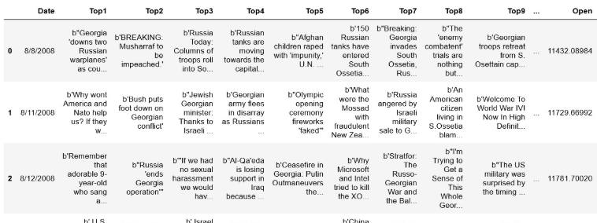
Preprocessing Dataset – Data Merging
First step was combination of both the files ; We wanted the stock price data to concatenate with the reddit news headlines data. Our final dataset was called – CombinedStockNews.csv with 1988 unique dates and each date have Top 25 News Headlines and Stock Market Features.

Slide 11
Preprocessing Dataset - Cleaning
Eliminating unwanted characters from news headlines.
Eliminating missing values – replace them with either ‘’ or NaN .
Added additional features of stock price variations - creating new columns
1. Net Change (Open Stock Price – Closing Stock Price)
2. Net Increase (Highest Stock Price – Open Stock Price)
3. Net Decrease (Open Stock Price – Lowest Stock Price)
4. Target Variable ( 1 if stock prices increases, 0 if stock prices decrease)

Slide 12
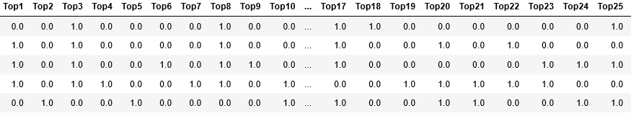
Sentiment Analysis – Labeling
We started with unlabeled data. We used NLTK library to label each of the top 25 news headlines for each day.
0 for negative, 1 for positive sentiment of a headline.

Slide 13
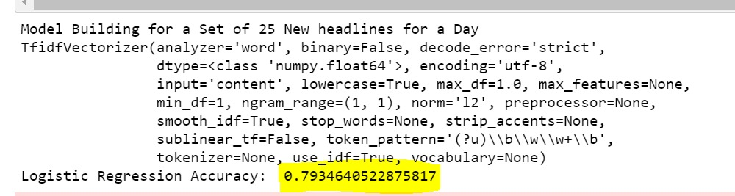
Sentiment Analysis – Modeling
We created positive and negative corpus from news headlines we previously labeled.
We build a sentiment analysis model (training – testing) to predict the sentiment of a set of new headlines.

Slide 14
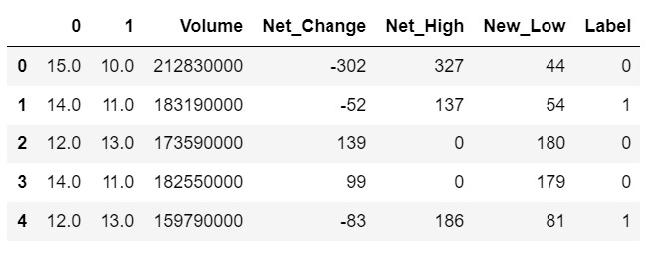
Model – Stock Prediction
We aggregated the number of positive and negative headlines for each day and prepared the data frame while adding other features.

Slide 15
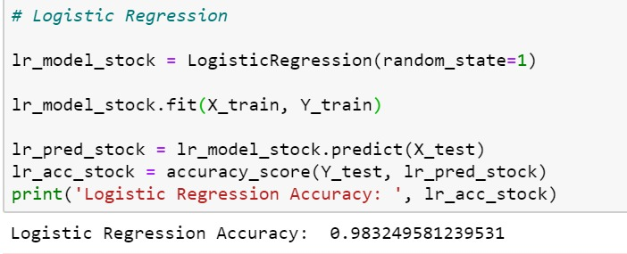
Model – Logistic Regression
We achieved an accuracy of 98.32% with Logistic Regression.

Slide 16
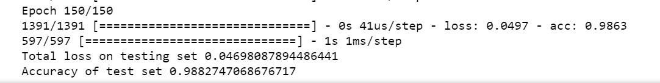
Model – Neural Network
We achieved an accuracy of 98.8 with Neural Network.
Using batch size of 100 and Epoch – 150.

Slide 17
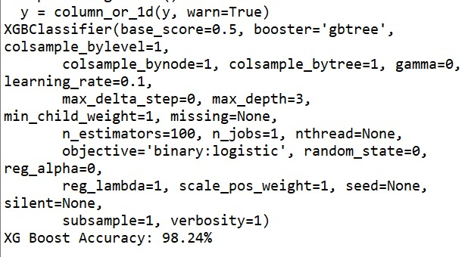
Model – XG Boost
We achieved an accuracy of 98.24 with XG Boost model.

Slide 18
Implications and Discussions
There is a high correlation between the top news headlines and the movement of stock market on any given day.
Using the sentiment analysis model , we are now capable of predicting the sentiment of a set of news headlines.
Using this analysis combined with the stock prediction model, we recommend that the features used , will be beneficial in predicting the fluctuation of stock market.

Slide 19


THE END

